Slide 1
Grade 9 Fitness Circuit Activity

Slide 2
Upper Body Exercises

Slide 3
Push-Ups

Slide 4
Shoulder Touches

Slide 5
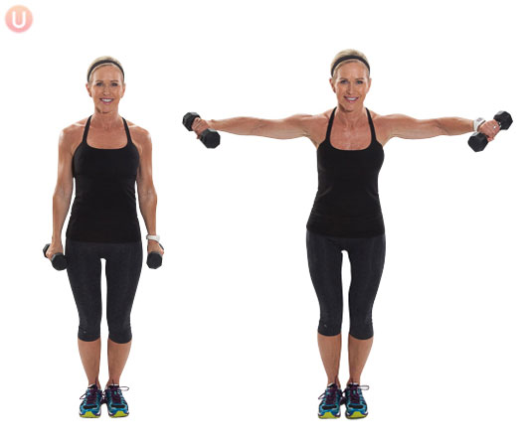
Lacteral Raises

Slide 6
Core Exercises

Slide 7
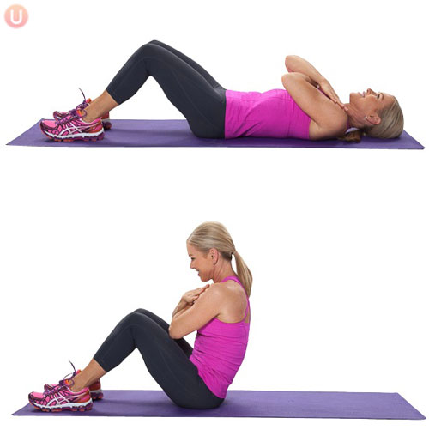
Sit-Ups

Slide 8
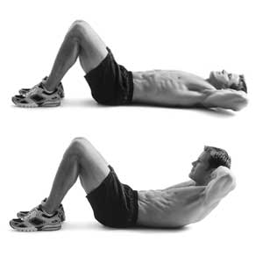
Crunches

Slide 9
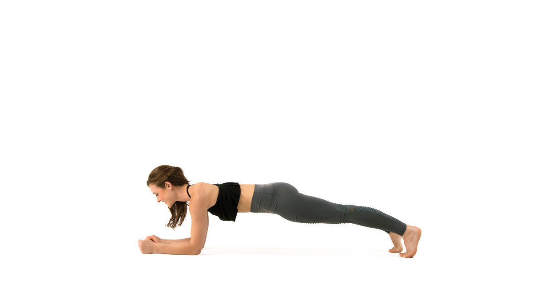
Plank

Slide 10
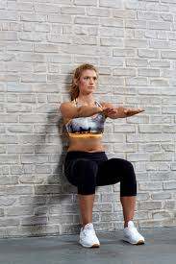
Wall Sit

Slide 11
Lower Body Exercises

Slide 12
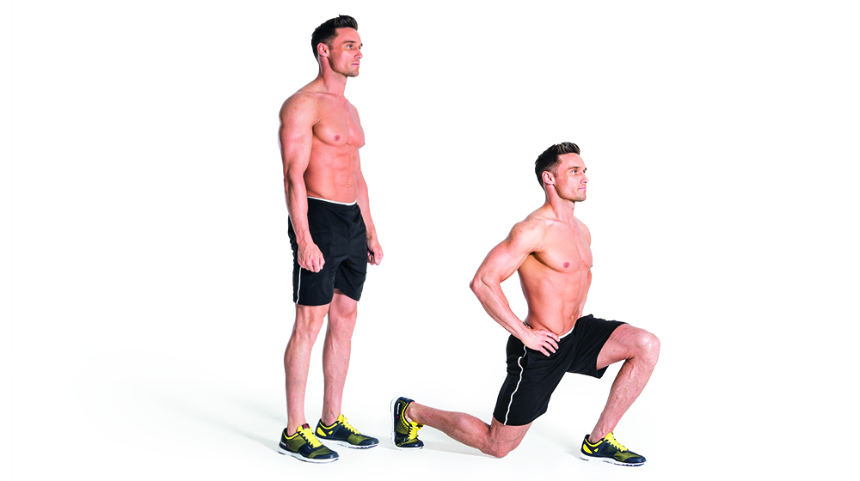
Lunges

Slide 13
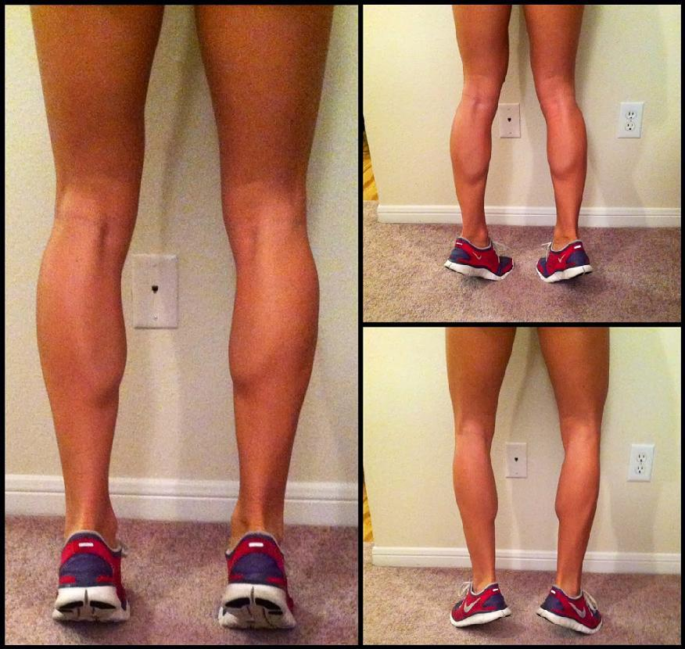
Calf Raises

Slide 14
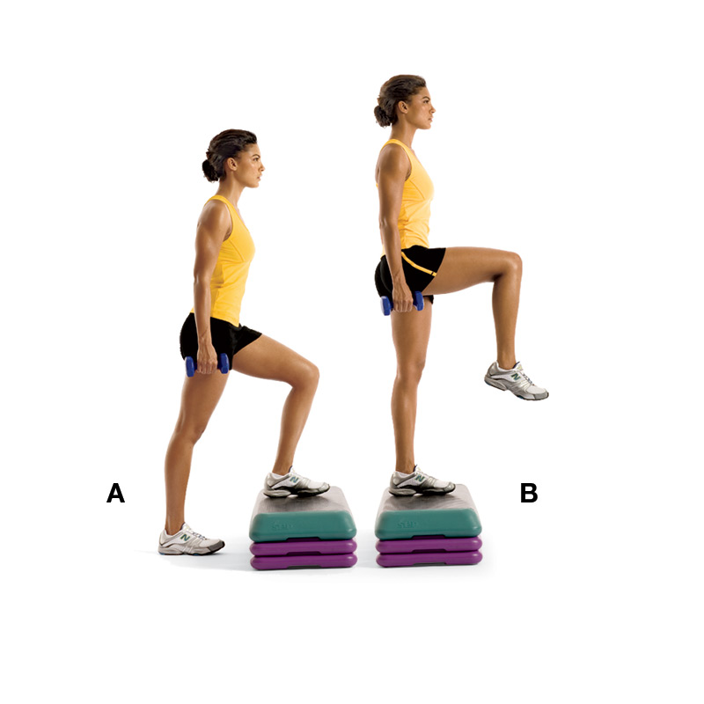
Step Ups

Slide 15
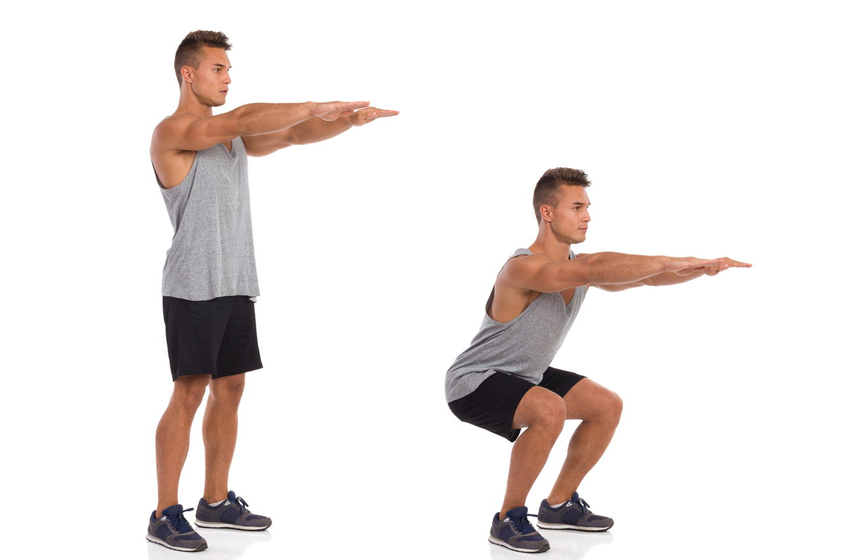
Squats

