Slide 1
Getting Started
in
Edsby
Pembina Trails School Division

Slide 2
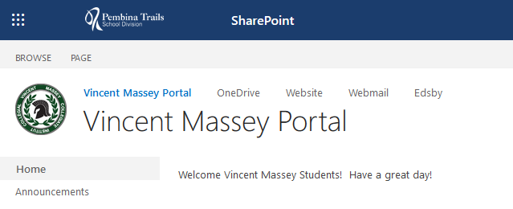
How do I get to Edsby?
1. From the School Portal…

Slide 3
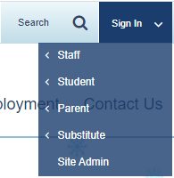
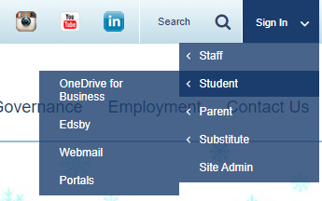
How do I get to Edsby?
2. From the website…

Slide 4
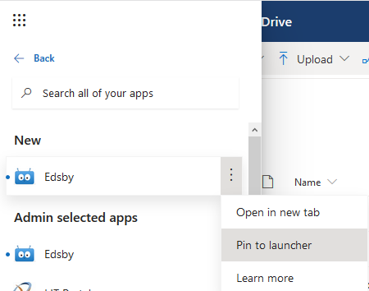
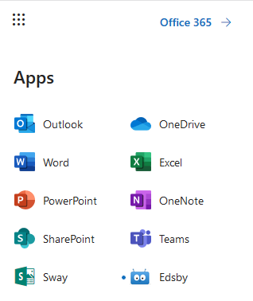
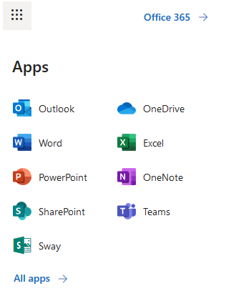
How do I get to Edsby?
3. From the Office 365 Waffle…

Slide 5
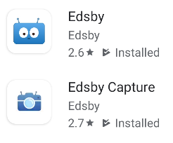
Can I use my phone?
1. Download the apps

Slide 6
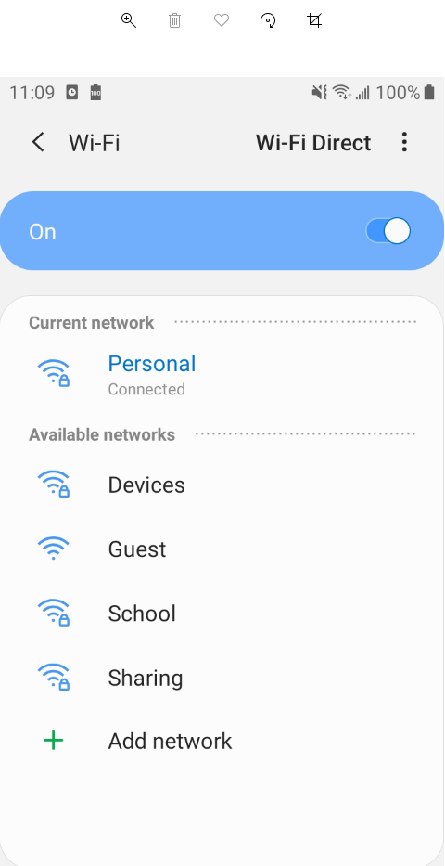
Can I use my phone?
2. Set your Wi-Fi to Personal
If you change your Pembina Trails password, you may have to
go into Wi-Fi Settings, “Forget network” and then re-connect.

Slide 7
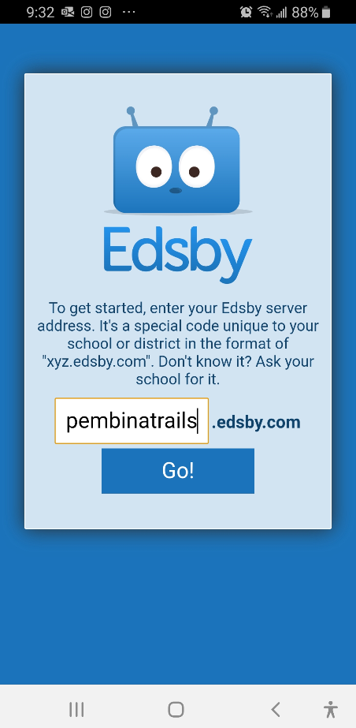
Can I use my phone?
3. In the Edsby app, set the server address
“pembinatrails”
press Go!
The server address “pembinatrails” should be lowercase and there should be no spaces before, within, or after.

Slide 8
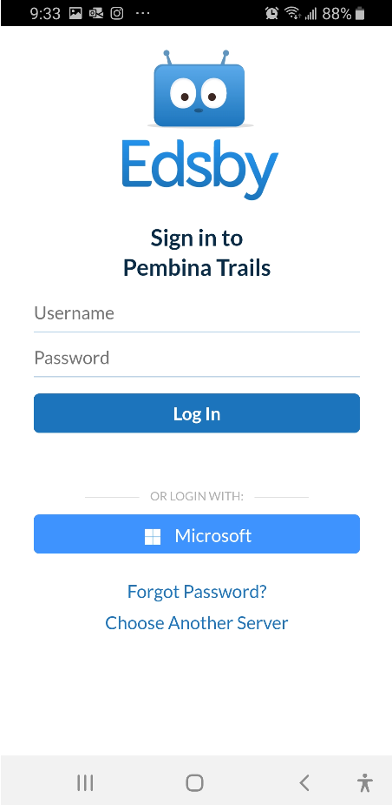
Can I use my phone?
4. In the Edsby app, sign in
Staff and students, just click the Microsoft button
Top area is just for parents!
Just for parents!

Slide 9
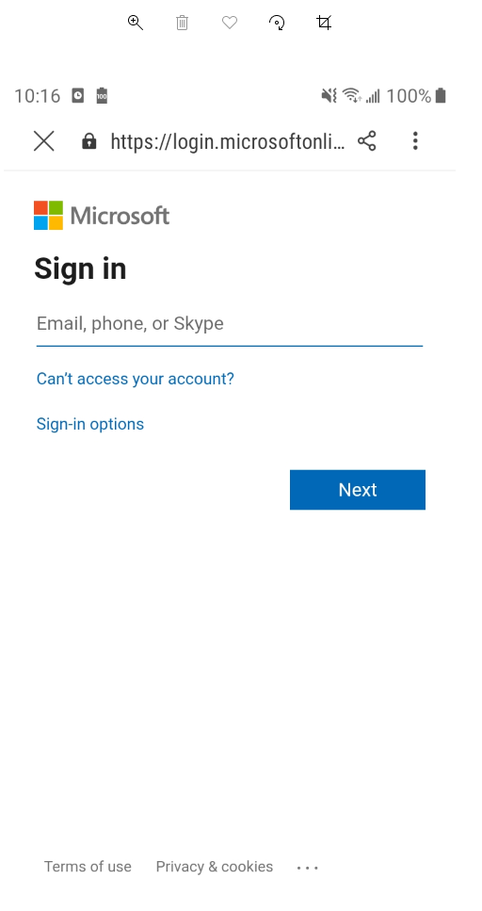
Can I use my phone?
5. In the Edsby app, sign in
enter your Pembina Trails email address
click Next
jsmith@smail.pembinatrails.ca

Slide 10
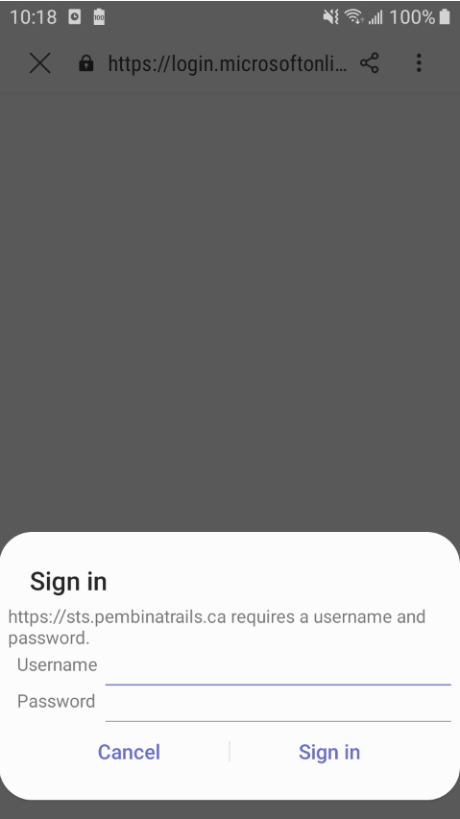
Can I use my phone?
6. In the Edsby app, sign in
enter your Pembina Trails username and password
click Sign In
wait
If using a shared device (eg. school iPad)
NEVER select any options to
“Remember Me” or “Keep me signed in”
jsmith
*******

Slide 11
Can I use my phone?
If you get an error message on log in, try this:
On your phone, go to one of the Office 365 apps
(OneDrive, School Portal or Outlook)
2. Log in if prompted
3. Go back to Edsby and try to sign in again
jsmith
*******

Slide 12
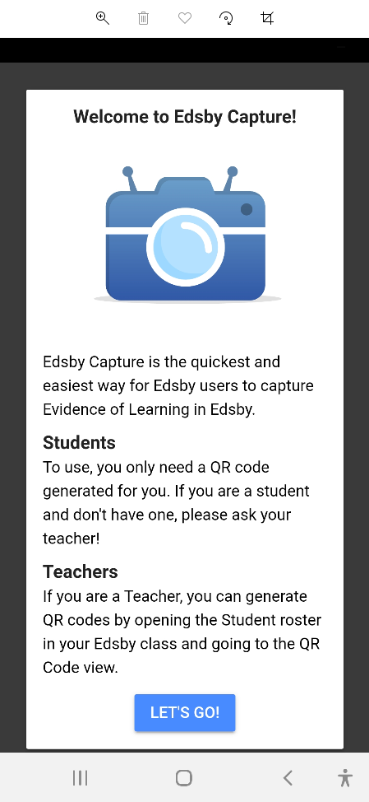
Can I use my phone?
7. In the Edsby Capture app
Click LET’S GO!

Slide 13
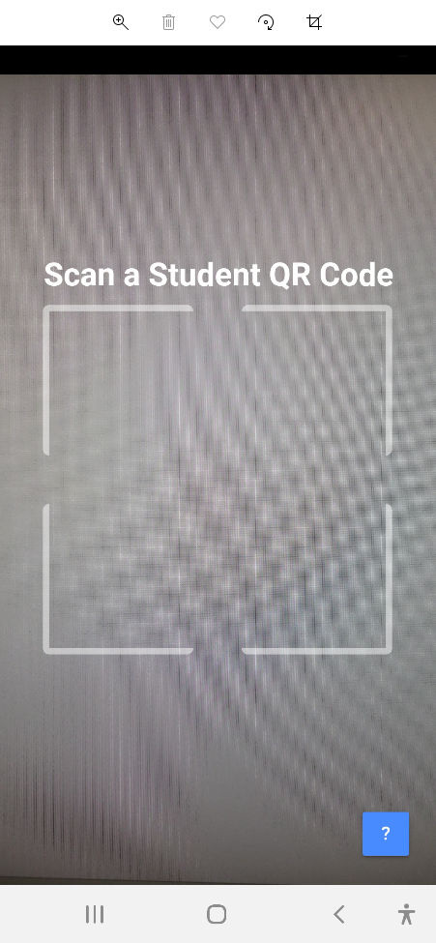
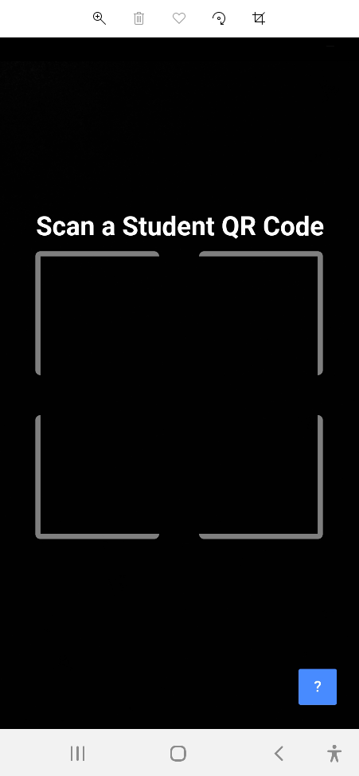
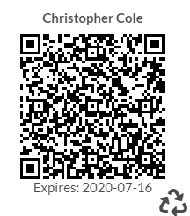
Can I use my phone?
8. In the Edsby Capture app
Scan the QR code (ask your teacher)
Not working? Click the ?

Slide 14
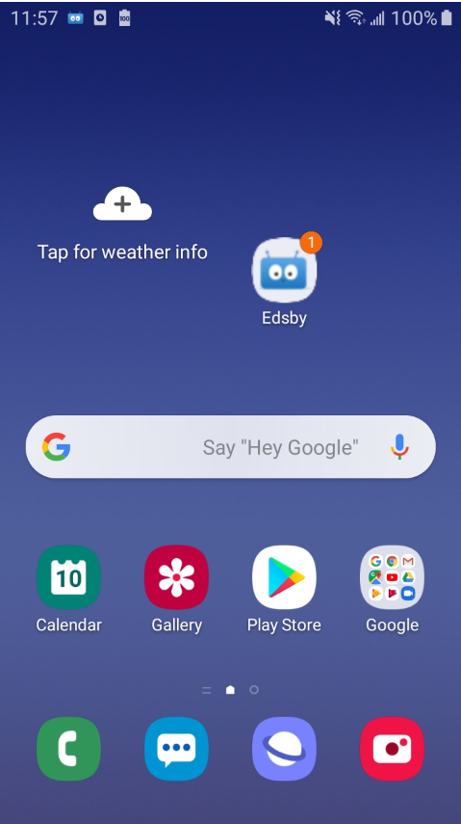
How do I set Notifications?
Push
There are 3 kinds of notifications:
Edsby
Email

Slide 15
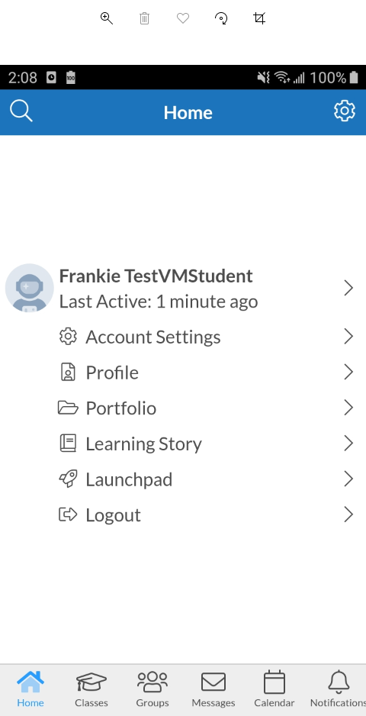
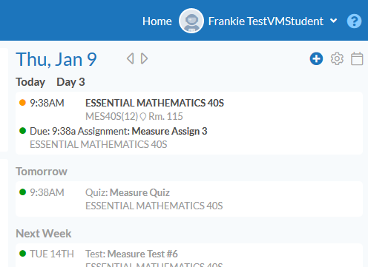
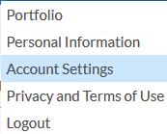
How do I set Notifications?
1. Go to Account Settings
In Edsby app, just click Account Settings
In Edsby, click your name, and then Account Settings

Slide 16
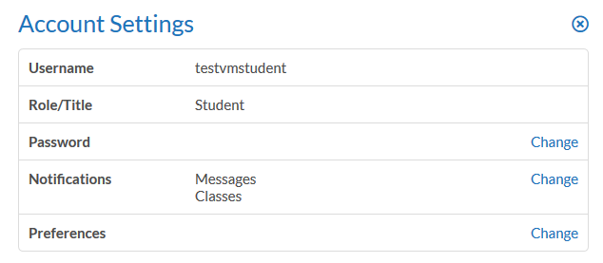
How do I set Notifications?
2. Beside Notifications, click Change

Slide 17
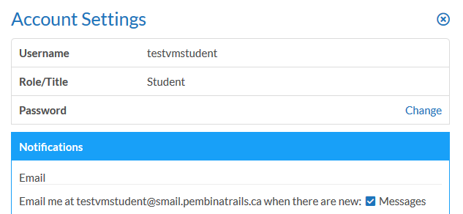
How do I set Notifications?
3. Messages are emailed to you when the box is checked (keep it checked!)

Slide 18
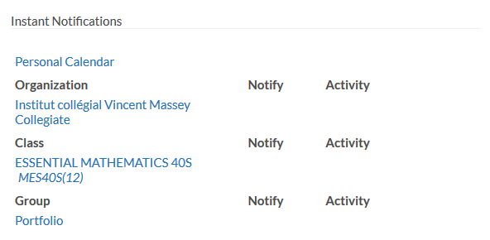
How do I set Notifications?
4. You will need to set Instant Notifications for
Personal Calendar
Organization
Classes
Groups

Slide 19
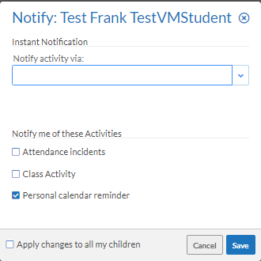
How do I set Notifications?
5. Set Calendar notifications
Click Personal Calendar
Click the down arrow
Click Edsby
Do the same for Email and Push as desired
Select the types of Activities as desired
Click Save

Slide 20
How do I set Notifications?
5. Set Calendar notifications
Notice that the type and activities are now displayed

Slide 21
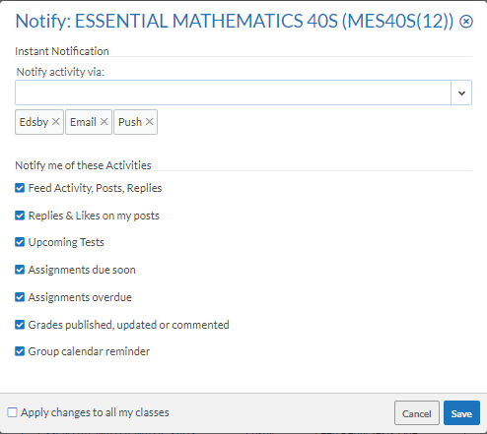
How do I set Notifications?
6. Do the same for Organization, Classes and Groups
For Classes and Groups, click Apply changes to all my classes (or groups) to copy the settings to all of your classes (or groups)

Slide 22
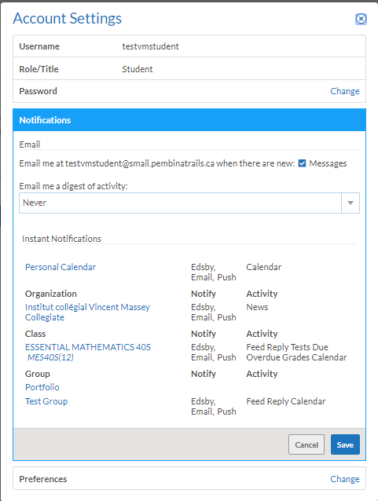
How do I set Notifications?
7. Click Save to save all Notification settings
Remember that you have to set up Notifications again whenever you are added to new Classes or Groups!

Slide 23
How do I set Notifications?
8. Check Edsby daily, whether you get a notification or not!
(every phone is different and there are various reasons why Push notifications may fail)
Sometimes it may take a day or two for Edsby Push notifications to kick in, so set up the notifications and then hold tight…

Slide 24
Go Edsby!

